Slide 1

Tabular data

Slide 2

Spreadsheets and databases rule the world!
Ariel Fischman holds the Guinness World Record for owning the most spreadsheet software (over 500!)
https://techcommunity.microsoft.com/t5/excel-blog/guinness-world-records-the-largest-collection-of-spreadsheet/ba-p/216592

Slide 3
What is tabular data?
Unlike arrays, each column can represent another type of value, with different data types
Date (index) | Wind speed | Wind direction | Rain fall (mm) | Hours of sun
7.3.2024 | 7.1 | N | 0.0 | 10
8.3.2024 | 0.3 | NW | 2.1 | 2
9.3.2024 | 1.1 | SE | 0.3 | 5
Subject ID (index) | Condition ID | Presentation nr | Response time (ms) | Response
VM | 732 | 2 | 28 | LEFT
VM | 732 | 3 | 41 | RIGHT
PB | 665 | 1 | 73 | LEFT

Slide 4
What is tabular data?
Column and rows have meaningful labels (indices) that are attached to the data for each operation
Date (index) | Wind speed | Wind direction | Rain fall (mm) | Hours of sun
7.3.2024 | 7.1 | N | 0.0 | 10
8.3.2024 | 0.3 | NW | 2.1 | 2
9.3.2024 | 1.1 | SE | 0.3 | 5
Subject ID (index) | Condition ID | Presentation nr | Response time (ms) | Response
VM | 732 | 2 | 28 | LEFT
VM | 732 | 3 | 41 | RIGHT
PB | 665 | 1 | 73 | LEFT

Slide 5
Many tools to handle tabular data
Python tools
pandas: in-memory tabular data
dask: on-disk tabular data
SQL databases
Optimized for retrieving rows (tree data structure for index)
Transactional: groups of operations are either all executed, or none
Columnar DBs, Spark, Hadoop
Optimized for operations on columns
Ideal for data science tasks
Operations can be automatically distributed over multiple machines

Slide 6
Tabular data ideas and operations are universal for all tabular data tools
Pandas
df.groupby(‘condition_id’)[‘response_time’].mean()
dask
df.groupby(‘condition_id’)[‘response_time’].mean()
PySpark
df.groupby(‘condition_id’).avg(‘response_time’)
SQL
SELECT condition_id,
AVG(response_time) AS avg_response_time
FROM df
GROUP BY condition_id;

Slide 7

Introduction to Pandas
Live Coding
notebooks/030_tabular_data/ 010_pandas_introduction.ipynb

Slide 8
Introduction to Pandas
Live Coding
notebooks/030_tabular_data/ 010_pandas_introduction.ipynb
Main points:
A DataFrame is a tabular data structure
DataFrames have labeled columns and rows (“indices”)
Columns can be of different C-native dtypes
Operations are on columns by default
NaNs are interpreted as missing data and ignored in most operations
Strings (and dates) have a special accessor to perform vectorized string (or date) operations

Slide 9
Basic Pandas reference slide
Looking at data
df.head() : show the first 5 rows
df.tail() : show the last 5 rows
df.sample(n) : show n random rows
Attributes
df.shape : size of the table
df.dtypes : print dtype of cols
df.columns : column index
df.index : rows index
Indexing
df[‘age’] : get column ‘age’
df[[‘age’, ‘name’]] : multiple columns
df.iloc[0, 2] : one element, by position
Exploration
df[‘name’].unique() : unique values
df[‘age’].describe() : summary stats
df[‘age’].value_counts(dropna=False) : number of rows per unique value in column
Adding a column
df[‘new’] = df[‘age’] * 3.1 : add new column
Filtering
df[df['age'] > 30] : select rows where condition is True
Operations
df.min(), .max(), .mean(), .std(), etc. : column-wise operations
df.count() : count of non-NaN elements in columns
df.sort_values(‘name’) : reorder rows by values of column ‘name’
df.sort_index() : reorder rows by the index values
String operations
df[‘name’].str : accessor for operations on the strings in a col
df['name'].str[2:4] : slice the strings in a col
df['name'].str.count(‘a’) : count the letter ‘a’ in the string in a col

Slide 10

Tabular data example from the lab
Research question: Does neuronal activity change over time? Does this depend on the overall activity level of the neuronal network? The mainstream theory suggests that neural activity is self-regulating to maintain a baseline level (“homeostatic plasticity”)
Exp design: patch clamp recordings from the same cells (or different cells/ same slices) before and after prolonged incubation in high potassium (K)
Potassium stimulates and TTX silences the entire network, allowing us to control the overall activity

Slide 11
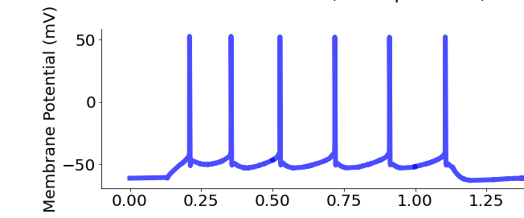
Variables
Applied Current
300 pA
Day 1 (D1)

Slide 12
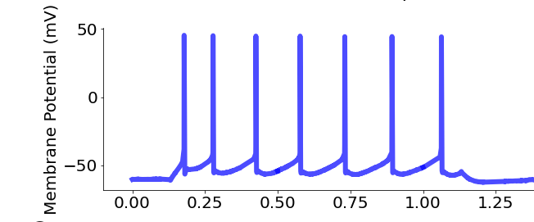
Variables
Applied Current
300 pA
Day 1 (D1)
Day 2 (D2)

Slide 13
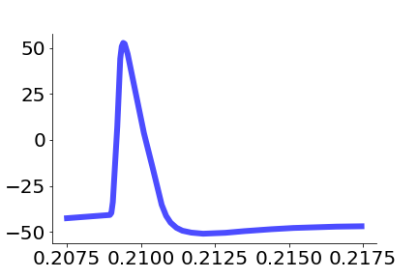
Variables
Day 1 (D1)
mV
Day 2 (D2)
Time (seconds)

Slide 14
Variables
Action potential (AP) properties
resting_potential = -74.3 mV
* *. *. * * *
max_spikes = 6
max_repol =
-91.4 mV/ms
Day 1 (D1)
AP_heigth
= 92.2 mV
mV
AP_halfwidth
= 0.91 ms
max_depol =
377.4 mV/ms
Day 2 (D2)
TH =
-39 mV
Time (seconds)
Time (seconds)

Slide 15

Hands-on Let’s have a look at the neural data
Exercise
exercises/pandas_intro
Use Pandas to explore the neural data
Submit a PR for Issue #2 on git.aspp.school/ASPP/2024-heraklion-data

Slide 16
TABULAR DATA OPERATIONS

Slide 17
Common operations on tabular data
Tabular data has additional needs compared to arrays. Understanding how to vectorize these operations is critical for handling them
Combine information across tables (join, anti-join)
Join: e.g., combine table with experiments results with table with experiments metadata (date, location, experimenter, free-form notes, …)
Anti-join: e.g. student compiles list of outliers, exclude them from the table of experiments to analyze
Summary tables (split-apply-combine)
E.g., compute average measurement and standard deviation by experimental condition and treatment dosage
Window functions to vectorize complex computations over groups
E.g., compute the time distance between experiments by lab technician

Slide 18
Joins

Slide 19
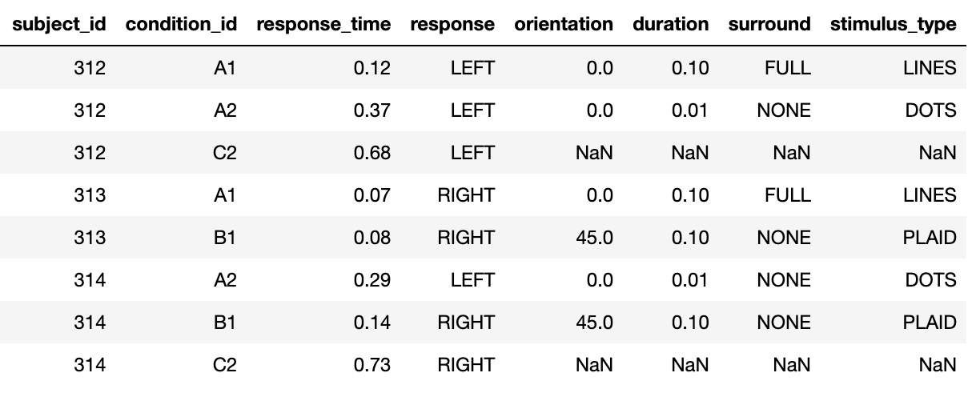
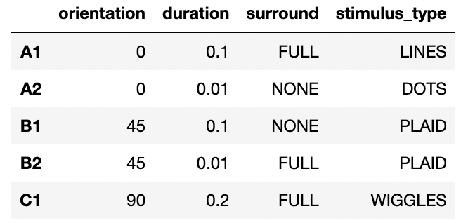
Join operations: combining informations from multiple tables
+
=

Slide 20
Join operations
Live Coding
notebooks/tabular_data/
020_join_operations.ipynb

Slide 21
Join operations
Live Coding
notebooks/tabular_data/
020_join_operations.ipynb
Main points:
Join operations can be used to combine two tables using the values of one or more columns
Different types of join:
left/right: keep all the column values that are present in the first/second table
inner: keep all the column values that are present in both tables
outer: keep all the column values that are present in one or the other tables
Anti-joins can be used to exclude the values that are present in one, but not the other table (filtering based on arbitrary criteria)

Slide 22
Hands-on
Exercise
exercises/tabular_join
Use joins to add experiment information to the neural data
Use anti-joins to remove outliers
Submit a PR for Issue #3 on git.aspp.school/ASPP/2024-heraklion-data

Slide 23
Split-apply-combine

Slide 24
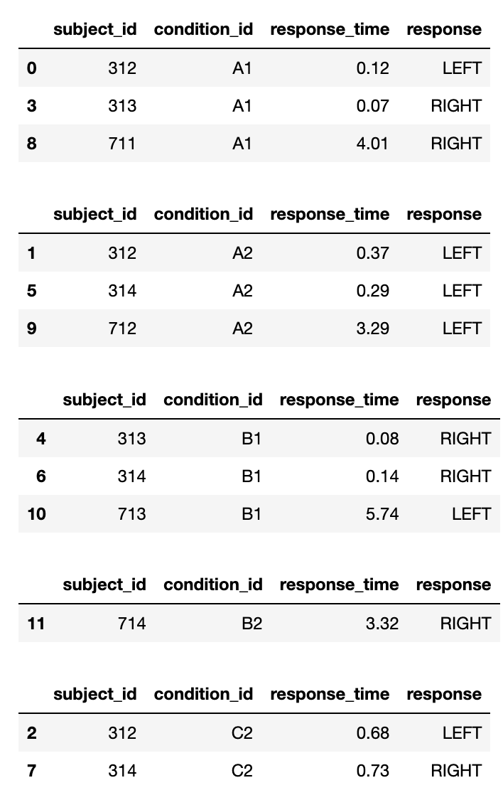
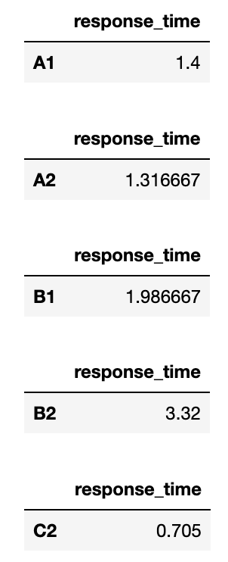
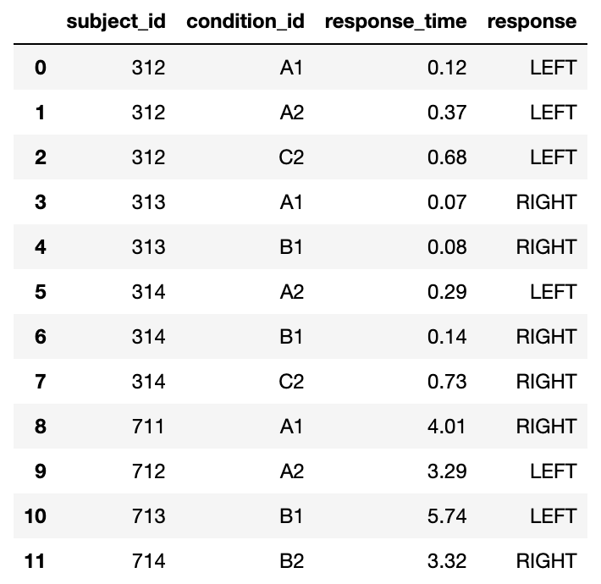
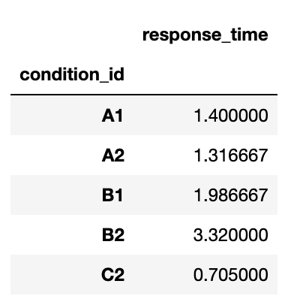
The basic structure of most numerical analyses
split
apply
combine
A1
A2
mean
B1
B2
C2

Slide 25
Split-apply-combine operations
Live Coding
notebooks/030_tabular_data/
030_split-apply-combine.ipynb

Slide 26
Split-apply-combine operations
Live Coding
notebooks/030_tabular_data/
030_split-apply-combine.ipynb
Main points:
Tabular data tools have a way to vectorize the standard split-apply-combine operations, using a “group-by” command
In addition, Pandas has got a “pivot-table” command that can be used to simplify the creation of more complex summary tables

Slide 27
df.groupby(‘condition_id’)[‘response_time’].mean()
split
apply
combine
A1
A2
mean
B1
B2
C2

Slide 28
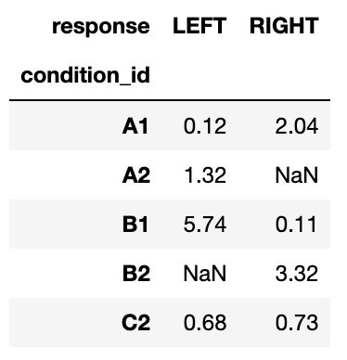
data.pivot_table( index='condition_id', columns='response', values='response_time', aggfunc='mean',
)
split
apply
combine

Slide 29
Hands-on
Exercise
exercises/ tabular_split_apply_combine
Compute summary statistics for the neural data
Submit a PR for Issue #4 on git.aspp.school/ASPP/2024-heraklion-data

Slide 30
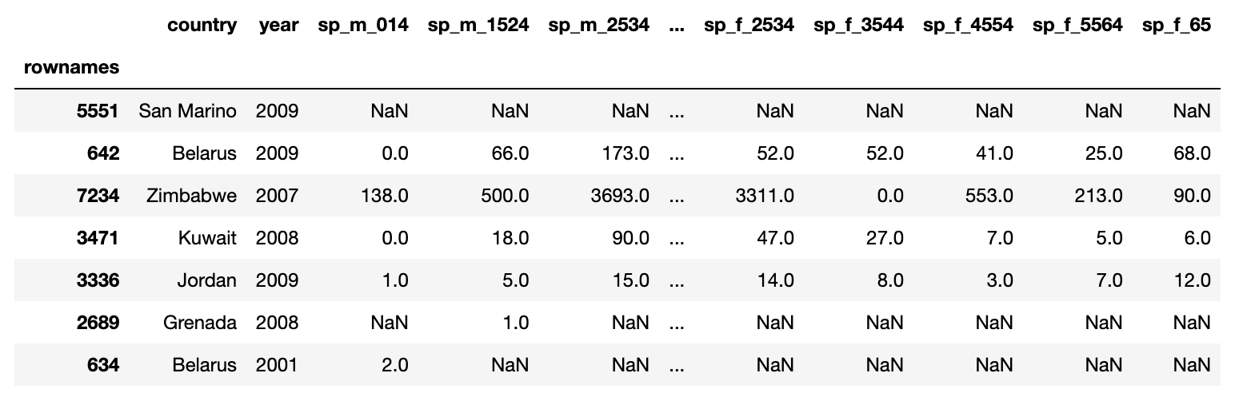
Hands-on
Exercise
exercises/tuberculosis
Compute some summary tables for the WHO tuberculosis data
Males
15-24 years

Slide 31
Tidy Data

Slide 32
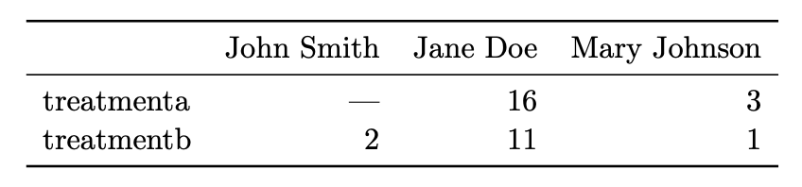
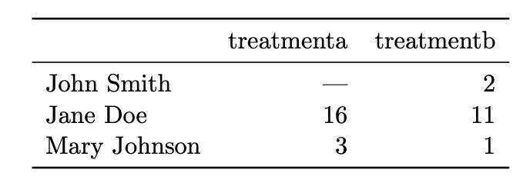
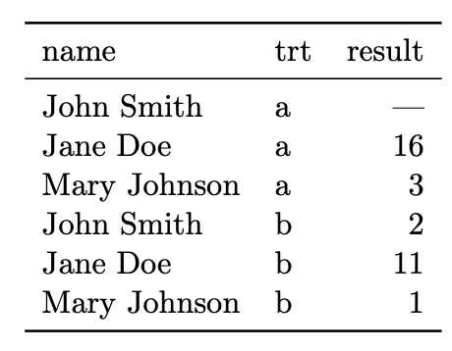
Same data, different organization Which one is best for data analysis?

Slide 33
Same data, different organization Which one is best for data analysis?
What do we want?
We want data to be in a natural format, such that data analysis is easy

Slide 34
Tidy data
In tidy data:
1. Each variable forms a column 2. Each observation forms a row 3. Each type of observational unit forms a table
Variables (or features, attributes)
Variables increase when new types of measurements are introduced
Subject ID | Condition ID | Trial nr | Response time (ms) | Response
VM | 732 | 2 | 28 | LEFT
VM | 732 | 3 | 41 | RIGHT
PB | 665 | 1 | 73 | LEFT
Observations (or samples)
Observations increase when new units (dates, subjects, …) are measured

Slide 35
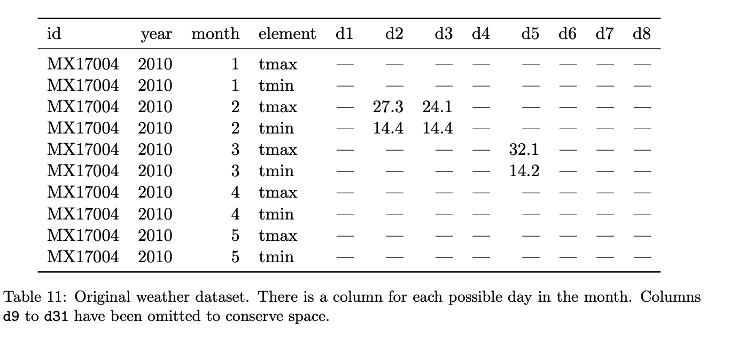
Hands-on
Identify variables, observations, and values. What would a tidy version look like?

Slide 36
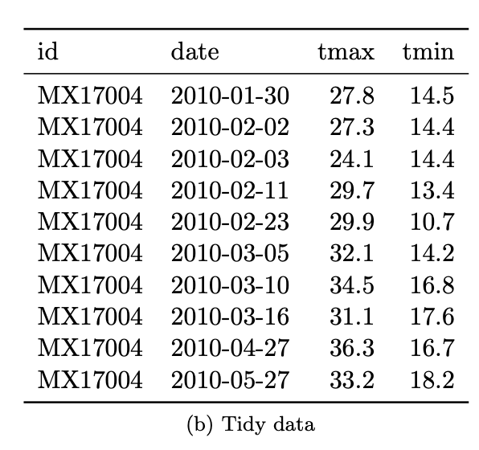
Hands-on
Identify variables, observations, and values. What would a tidy version look like?

Slide 37
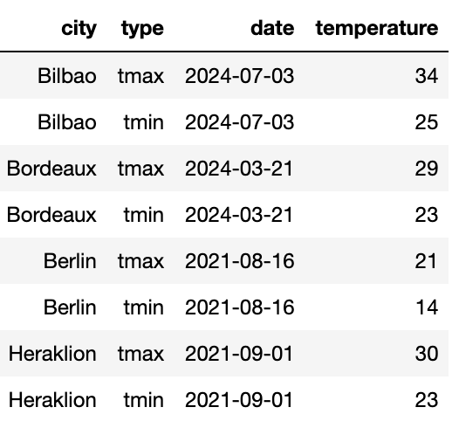
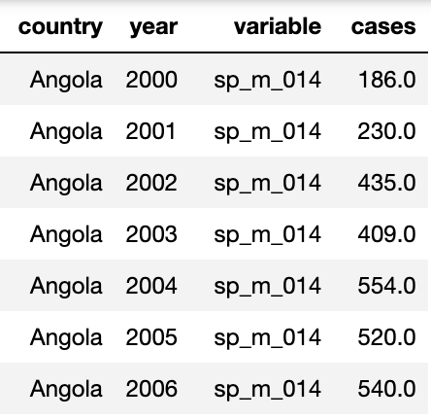
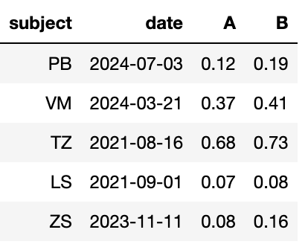
Messy data
“Tidy datasets are all alike but every messy dataset is messy in its own way” – Hadley Wickham
Variables are stored in both rows and columns
Some variables are stored in the file names
😱
😱
Multiple variables are stored in one column
Column headers are values, not variable names
2024-01_prices_DE.csv 2024-01_prices_FR.csv 2024-02_prices_DE.csv 2024-02_prices_FR.csv
😱
😱

Slide 38

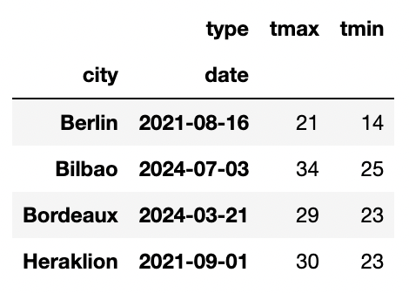
The life-changing magic of tidying up data
Pivoting – we know this one
The “type” column is storing variable names
😱
pivot
df.pivot_table( index=['city', 'date'], columns='type’, values='temperature', aggfunc='max’,
)

Slide 39

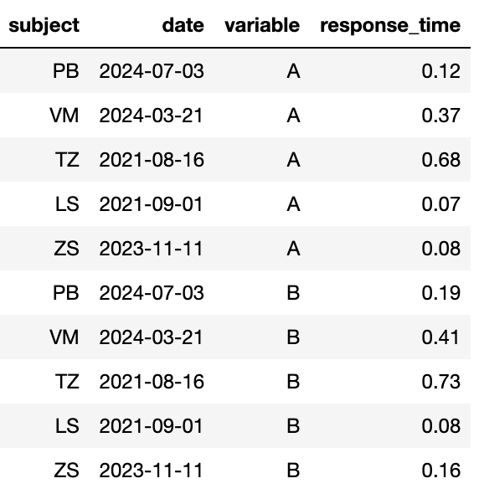
The life-changing magic of tidying up data
Melting – it’s kind of the opposite of pivoting
The treatment values are stored as a column name
😱
melt
pd.melt(data, id_vars=['subject', 'date'], value_name='response_time')
Split the columns in (A) “id_vars” and (B) non-”id_vars”. The column names in (B) are used as new values in a new column “variable”. The values in columns (B) go into a new column, “response_time”.

Slide 40

The life-changing magic of tidying up data
pd.concat – add together tables with the same variables (columns)
Some variables are stored in the file names
tables = []
for filename in filenames:
# Parse filename
year_month, _, country = filename[:-4].split('_')
# Read table and add columns for the variables
df = pd.read_csv(filename)
# Add the variables that were in the filename
df['year_month'] = year_month
df['country’] = country
# Store table
tables.append(df)
# Create complete table
tidy_df = pd.concat(tables)
😱
2024-01_prices_DE.csv 2024-01_prices_FR.csv 2024-02_prices_DE.csv 2024-02_prices_FR.csv

Slide 41
Hands-on
Exercise
exercises/tabular_tidy_data
Tidy up the data set in the tuberculosis exercise and compute the summary stats
Submit a PR for Issue #5 on git.aspp.school/ASPP/ 2024-heraklion-data
Multiple variables are stored in one column
😱

Slide 42
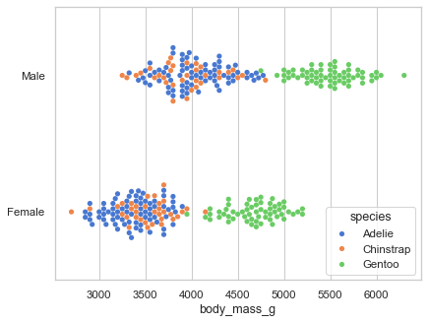
Why is tidy data good?
Many analyses require a simple sequence of steps:
Filter by individual variables to discard data that is not needed
Group and summarize
Re-arrange (e.g. sort)
Visualize
Joining tidy tables is easy!
One can write generic code that takes tidy data as input. For example, seaborn relies on tidy data to make complex plots
sns.swarmplot(
data=df,
x="body_mass_g",
y="sex",
hue="species”,
)

Slide 43
Window functions

Slide 44
Window functions: grouped row-by-row operations
“Window functions” are a kind of split-apply-combine operation, but instead of aggregating the data in a group and returning one value per group, they return one value per row
Examples: ranking all entries in a group; computing the distance between timestamps per group; number the rows by group in chronological order
In Pandas, most of these operations can be performed with a combination of sorting and grouping-by

Slide 45
Window functions
Live Coding
notebooks/tabular_data/
040_window_functions.ipynb

Slide 46
Window functions
Live Coding
notebooks/tabular_data/
040_window_functions.ipynb
Main points:
Window functions perform row-by-row operations on grouped data
They are an advanced way of avoiding for loops with tabular data
In Pandas, they can be achieved with a combo of sorting and grouping-by

Slide 47
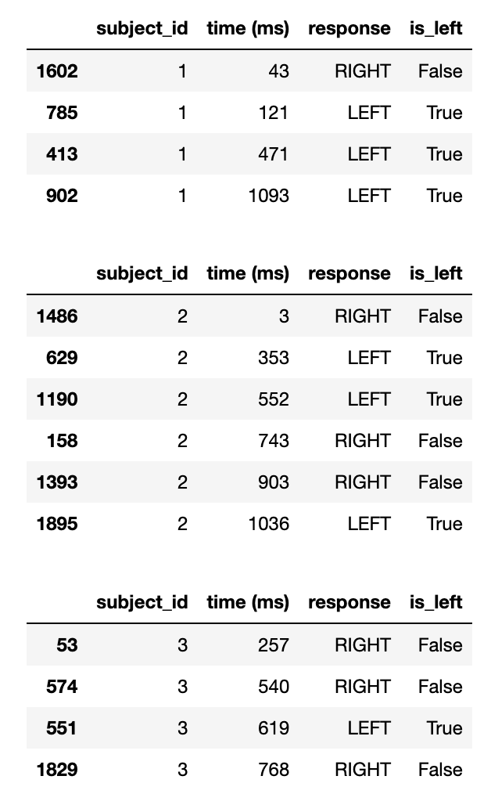
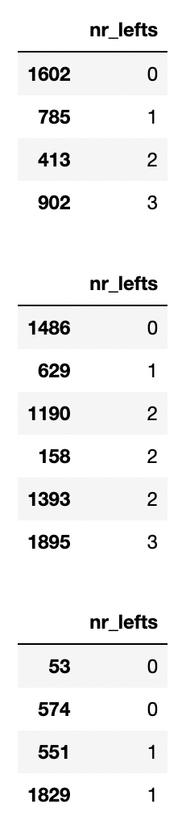
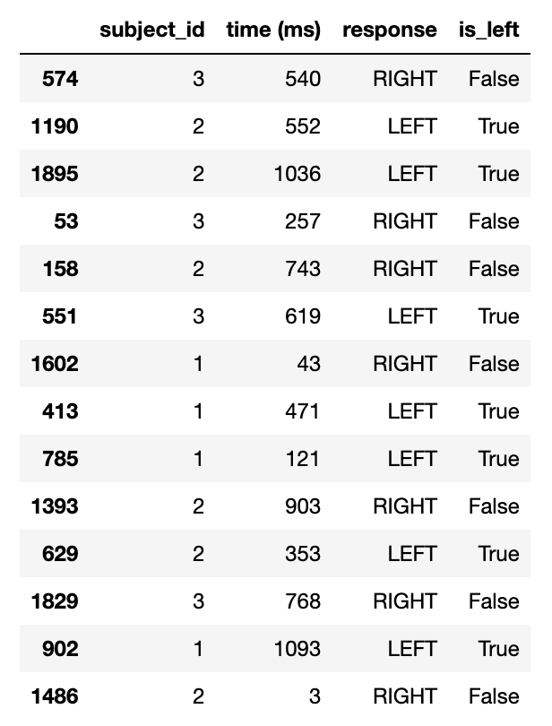
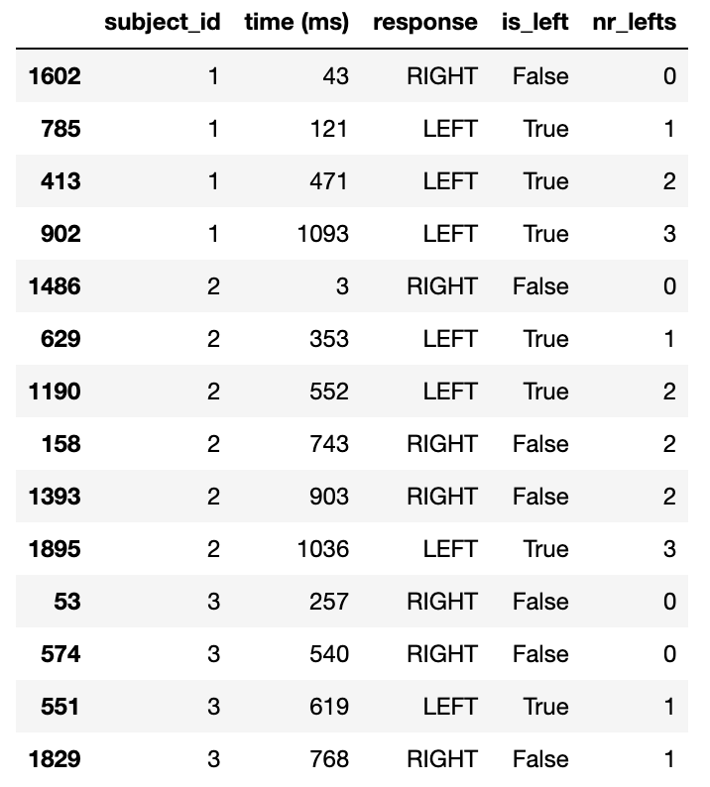
Window functions operations
df['nr_lefts'] = df.sort_values('time (ms)').groupby('subject_id')['is_left'].cumsum()

Slide 48
Hands-on
Exercise
exercises/
tabular_window_functions
Compute the average number of days each patcher waited between experiments
Submit a PR for Issue #6 on git.aspp.school/ASPP/2024-heraklion-data

Slide 49
Global summary
There are many different data structures, each specialized in efficiently processing one type of data
Code performance grows differently with data size: Big-O
NumPy array efficiently store data in a C-native memory block, interpreted as an array using some metadata
NumPy operations that only need to change the metadata do so, creating a view of the same memory block. These operations are O(1)!
Tabular data can also be vectorized using joins, anti-joins, split-apply-combine operations, and window functions
For these operations to be efficient and painless, data should be stored in a tidy data format

Slide 50
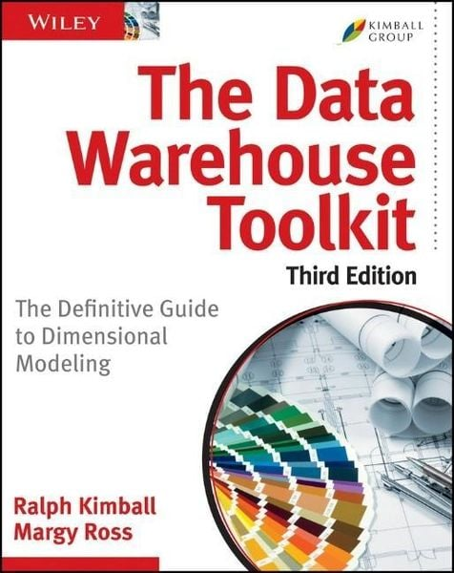
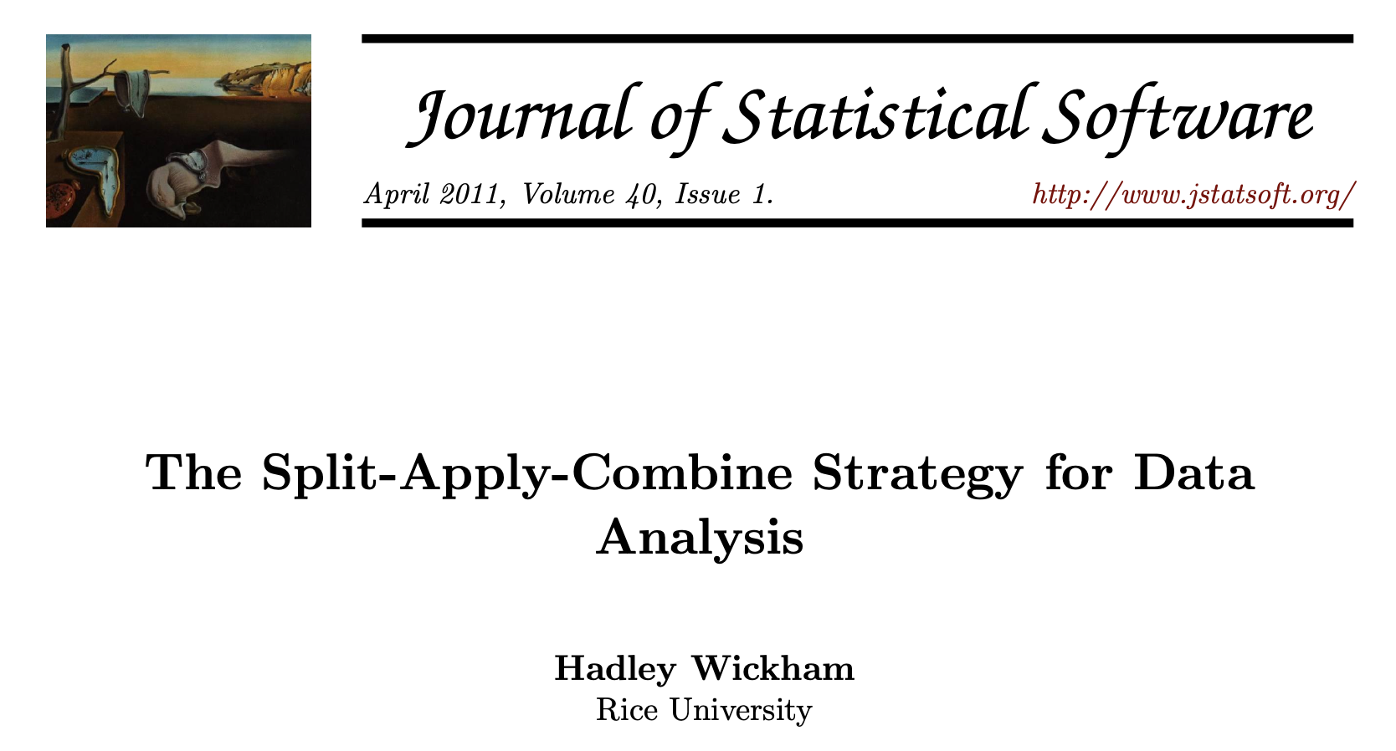
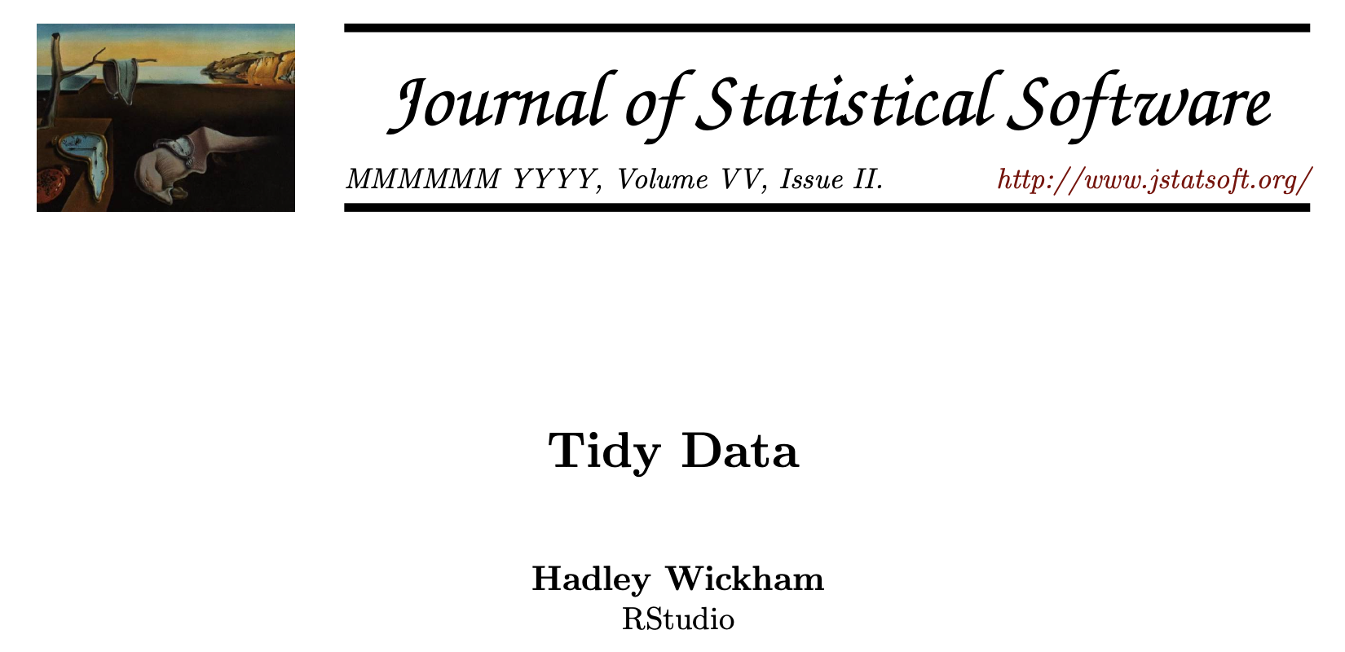
What we didn’t talk about
Other data structures: graphs, trees, priority queues, …
Options for working with large data on disk / remotely (instead of in-memory)
Best practices in data handling: versioning, lineage, sharing
Organizing a complex data set in multiple tables
… and a lot more!

Slide 51

Thank you!

Slide 53
Data organization
Data organization concepts:
tidy data
normalized data (star organization)
data science friendly data (denormalized)

Slide 54
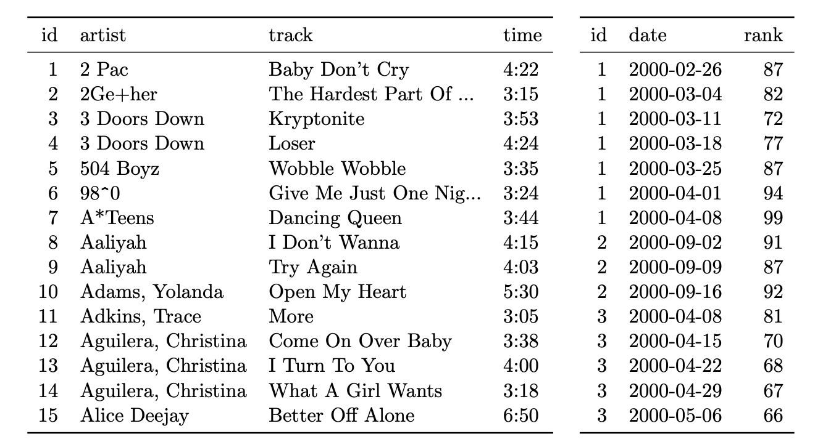
Organizing multiple tables
Dimension vs fact tables
De-normalization (but for data analys flat tables are more convienent)

Slide 55
Dealing with changes in the data
Recommendations:
NEVER overwite a data file. Treat data files as immutable
Use versioning for changes in the data file, and load the latest version for new analyses, old versions to reproduce previous results
(pond is a library I’m working on to automatize this process)
Like in computer code:
Adding new columns / rows is generally ok
Deleting/changing a column is not! Code will break! Add a new column instead

